Slide 1


67 East 161st Street — Bronx, NY
Ground-Up Build-to-Suit for Bronx Defenders • May 2026
This presentation contains confidential and proprietary information intended solely for the recipient. It is provided for informational purposes only and may not be reproduced, distributed, or disclosed without prior written consent. By accepting this presentation, you agree to maintain its confidentiality and use the information solely to evaluate a potential investment opportunity.

Slide 2
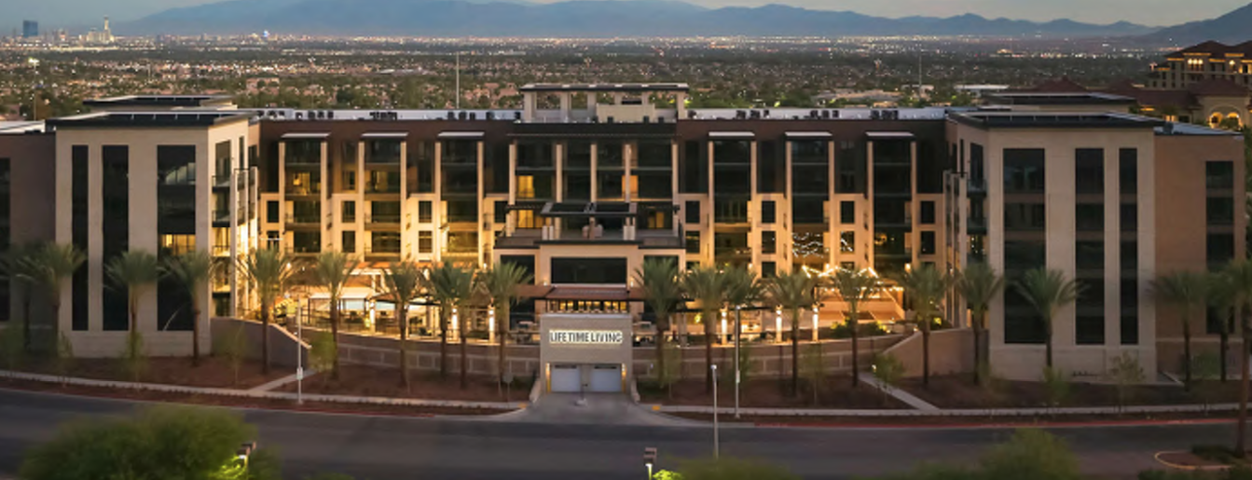

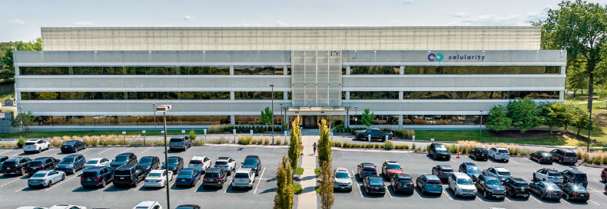

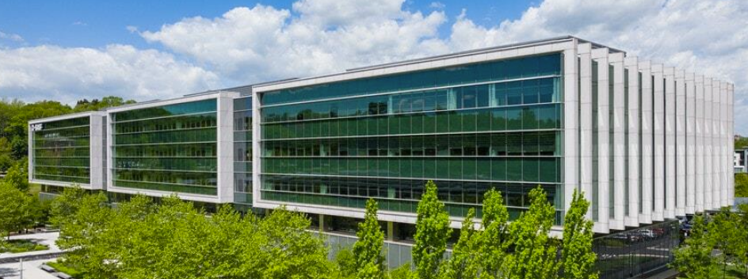

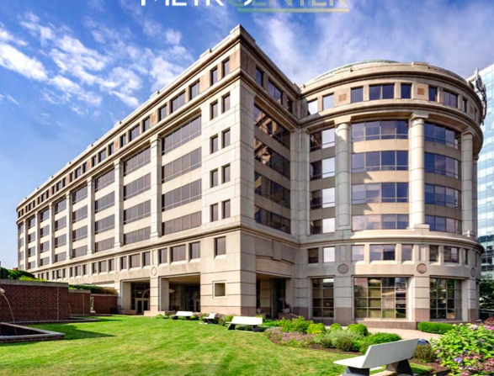
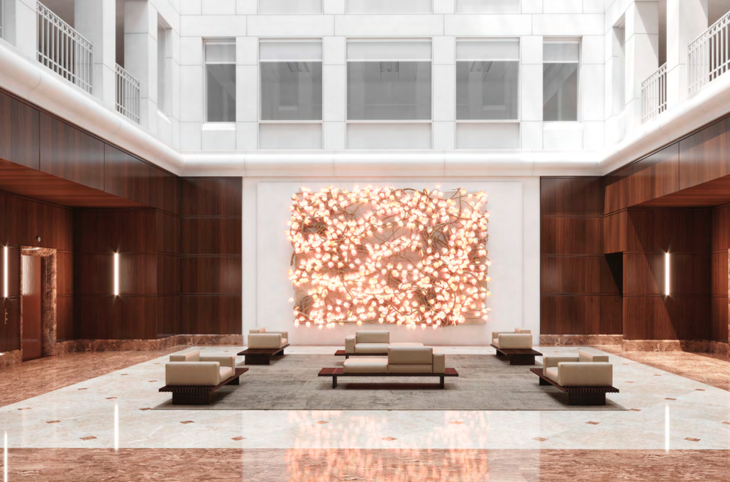

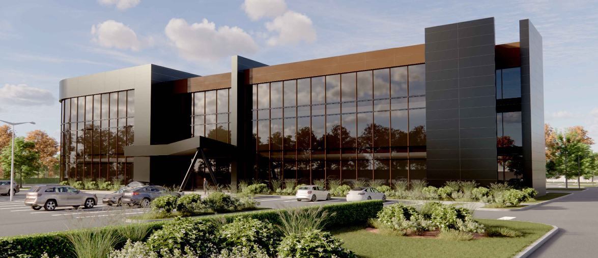
Site & Deal Structure
 | Step | Description | Status / Timing | Cost | Size
 | McDonald’s Lot | Acquire the east-end parcel from the McDonald’s franchisee. PSA signed 4/30/2026 with short due-diligence window. Closing subject to a 120-day Warren Act notice to the franchisee under NY franchise law. Site delivered vacant on a structured timeline that aligns with the Chase closing. | PSA Signed 4/30/26 | $9.25M | ~8,900 SF
 | Chase Lot | Acquire the adjacent parcel from JPMorgan Chase, which operates a retail branch on the site today. PSA signed June 2026; Chase is relocating its branch to the LX site directly across the street. Closing targeted December 2026 with vacant delivery of the existing branch building. | Closing Dec 2026 | $8.50M | ~11,610 SF
 | Tax Lot Merger | Merge the McDonald’s and Chase parcels into a single tax lot at combined closing. Aggregate site: 20,510 SF with 7.65 FAR, yielding ~157,000 SF of buildable mixed-use floor area. ULURP not required — site is as-of-right under existing R10/C2-4 zoning. | At Combined Closing | 20,510 SF site | 157K SF buildable
 | Ground-Up Construction | Demolish existing improvements and build a Class A mixed-use building. MJM Construction as GC; KSS Architecture. Critical-path schedule shows a 24-month construction cycle from foundation through TCO and punchlist (Q2 2027 → Q1 2029). Hard cost budget $56.9M ($381/SF); 4% project contingency held against scope risk. | Q2 2027 – Q1 2029 | $56.9M hard | 157K SF GBA
 | Condo Conversion & Delivery | File a condominium declaration and split the building vertically into two condo units: a 150,000 SF office condo for Bronx Defenders and a 7,000 SF ground-floor retail condo, with shared lobby/parking commons. Deliver the office condo to Bronx Defenders under the build-to-suit lease; retain the retail condo on the balance sheet. | Q1 2029 Delivery | 150K + 7K SF | BTS Condo Split
67 East 161st Street — Bronx Defenders Development

Slide 3
Pro-Forma Summary
Line Item | Detail | Period | Amount | $/SF | % of TPC | Stab. NOI | Exit / YoC | IRR / EMx (Base Case)
Land Assemblage McDonald’s + Chase | Dec 2026 | $17.75M | $113 | 17% | — |  | — | —
Hard Costs GC: MJM Construction | 2027–2028 | $56.87M | $362 | 55% | — | — | — | —
Soft + Contingency Arch / Eng / Permits | 2027–2028 | $10.88M | $69 | 10% | — | — | — | —
TI / LC / Dev FeeLease econ + 4% dev fee | 2028–2029 | $9.21M | $59 | 9% | — | — | — | —
Cap Int + Loan Fees Construction loan | 2027–2029 | $7.92M | $50 | 8% | — | — | — | —
Total Project Cost All-In Basis | Dec 2026 – Q1 2029 | $104.0M | $663 | 100% | $8.55M | 8.24% YoC | — | —
Exit @ 5.50% Cap 72-mo hold (Sale Dec 2032) | Dec 2032 | $155.4M |  | $990 / SF | $41.7M profit | 19.84% IRR | 2.03x EMx | Base case
Base case per FM 161st Development Model v5 (5.4.2026). Sale-at-stabilization scenario.
67 East 161st Street — Bronx Defenders Development

Slide 4
Tenant Overview — The Bronx Defenders
 | Topic | Description | Metric 1 | Metric 2 | Metric 3
 | Organization | The Bronx Defenders is a holistic public defense organization providing free legal representation, social work, and advocacy to Bronx residents charged with crimes or involved in the family or immigration systems. Founded in 1997, it pioneered the “holistic defense” model now adopted nationally. | Founded 1997 | ~400 staff | 501(c)(3)
 | Service Lines | Four integrated practice areas operating out of a shared facility: (1) Criminal Defense — representing indigent defendants in arraignments through trial; (2) Family Defense — representing parents in child-welfare proceedings; (3) Civil Action — housing, benefits, immigration; (4) Adolescent Defense — juvenile and youth advocacy. | 4 practices | ~35K cases/yr | Bronx County
 | Lease Terms | 15-year NNN build-to-suit lease for 150,000 SF (Floors 2–10) at $55.00/SF starting rent, with annual escalations. Rent commencement targeted 12/31/2029 at TCO. Bronx Defenders also has a TI work letter funded by FM at $12.50/SF as part of the project budget. | 15-year NNN | $55.00 / SF | 150,000 SF
 | Funding & Credit | Funded primarily through long-term annual contracts with NYC government (DSS, ACS, Office of Court Administration), supplemented by foundation grants and donations. The NYC indigent-defense funding stream is statutorily mandated and has grown consistently over the last 20 years — a stable, policy-backed revenue base. | NYC DSS / ACS | ~80% gov | Policy-backed
 | BTS Status | Initial lease proposal delivered 10/21/2025 and revised 10/27/2025. BXD redline response received 11/21/2025; open items are economic (free rent, escalations, TI funding mechanism) rather than structural. Work letter and BXD test fit both in draft. Targeted full lease execution Q3 2026. | Redline in | 11/21/2025 | Targeting Q3 2026
67 East 161st Street — Bronx Defenders Development

Slide 5
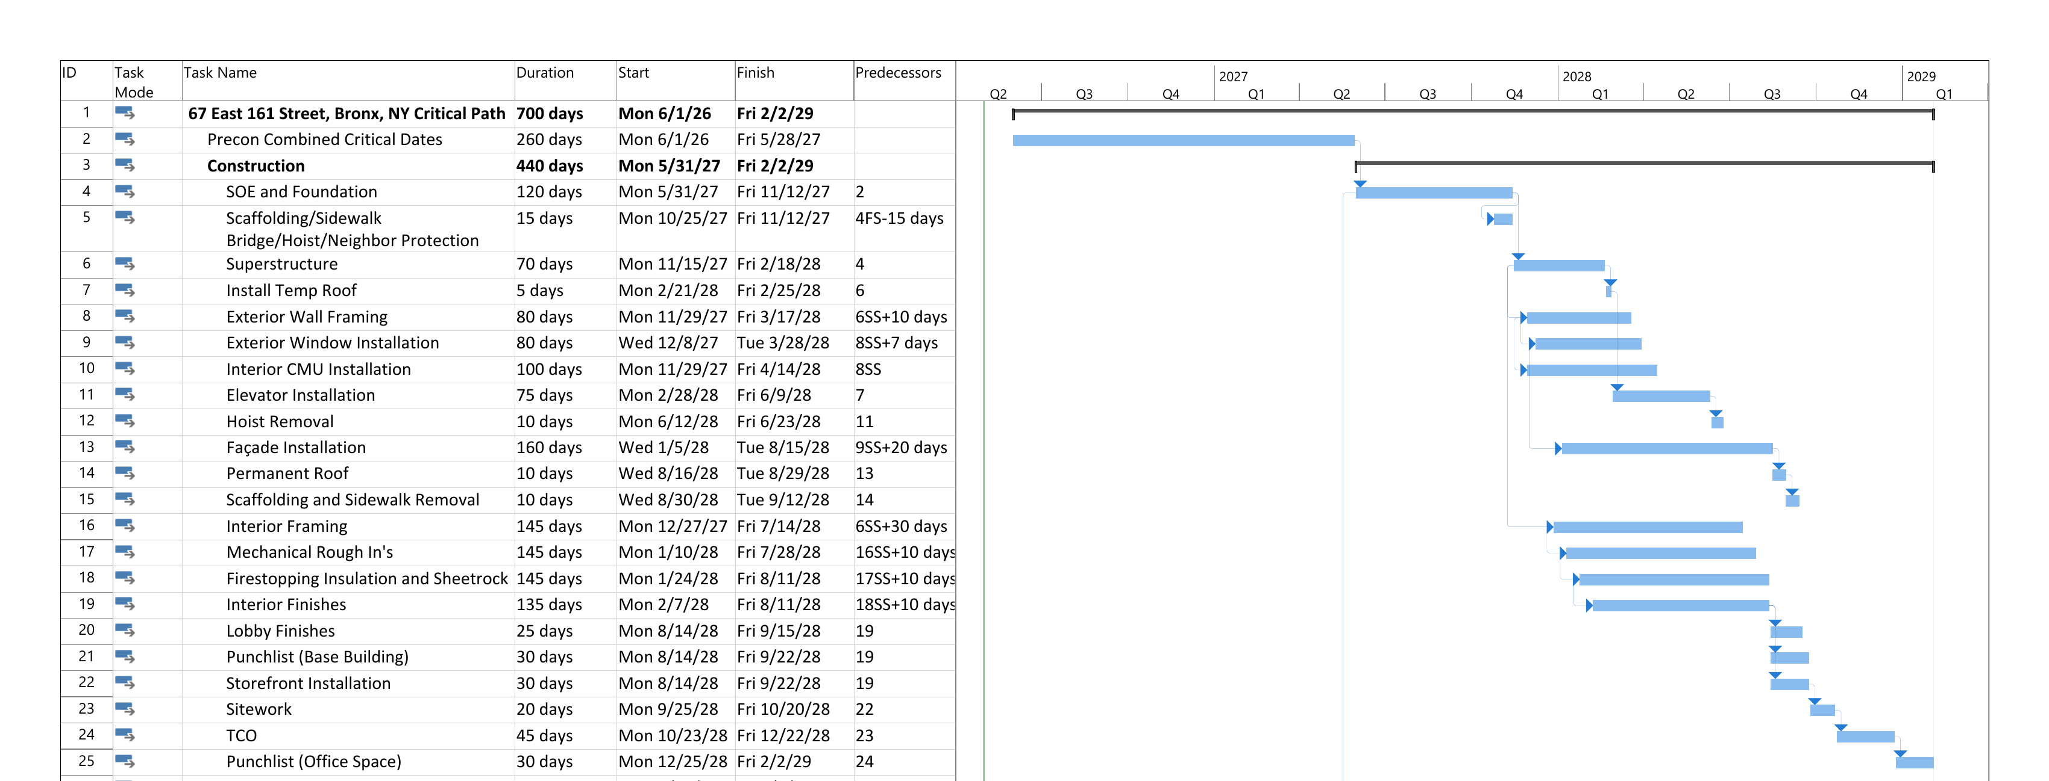
Project Schedule
Milestones
Land Close & Pre-Construction
SOE & Foundation
Superstructure & Temp Roof
Façade, MEP & Interior
TCO, Punchlist & Delivery
Phase
12 months
6 months
3 months
9 months
4 months
Q4 ’28 – Q1 ’29
Q3 ’26 – Q2 ’27
Q2 – Q4 ’27
Q4 ’27 – Q1 ’28
Q1 – Q3 ’28
Façade, MEP & Interior
Source: 67 E 161 Street Critical Path Schedule (5.1.2026). Phase durations rounded.
67 East 161st Street — Bronx Defenders Development

